Slide 1

"Team Wizards" presents
ATTENDANCE MANAGMENT SYSTEM USING FACIAL RECOGNITION
FireFly Hackathon
NII, NITW

Slide 2


Present, but Inefficient?
Attendance, an essential for every educational institute that needs to be taken care of everyday, mostly happens offline, which takes a lot of time, also requires stationary storing reord in an organized manner; also increases chances of proxy( pseudo-presence) and difficulty in maintaing previous records.

Slide 3
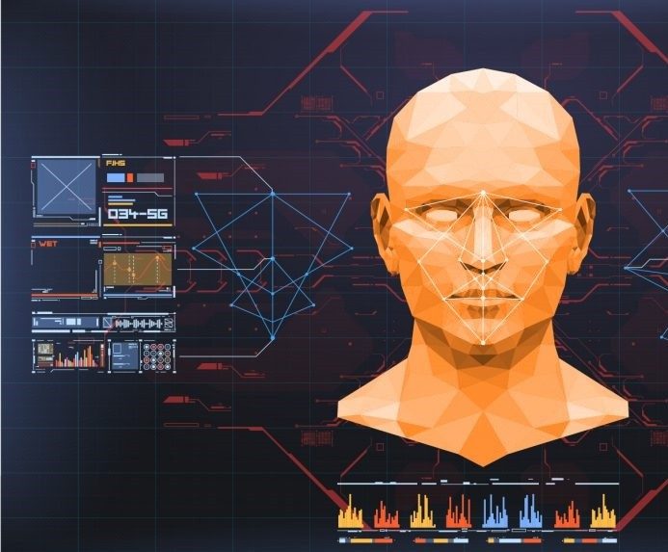
Our Solution
Using facial recognition technology for attendance management system will save a lot of time, also will eliminate any chances of discrepency/proxy and make this process error-free.
it can and is being widely used due to its contactless and non-invasive process.

Slide 4


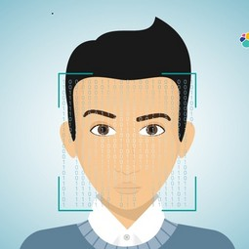




Tools & Softwares Used
Programming
Library
OpenCV
IDE
PyCharm
WebApp Developer
Language
Python
Library
Face
Google
Recognition
AppSheet

Slide 5


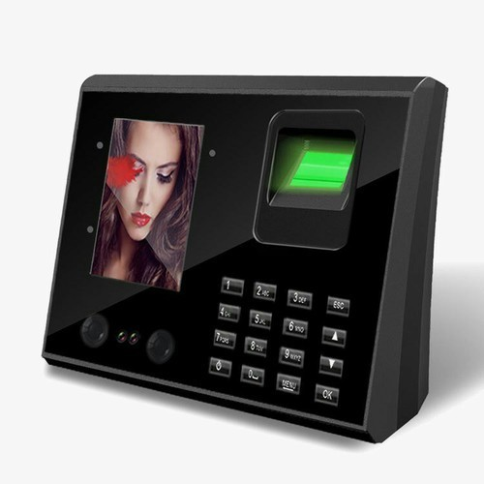
Our product vs competitors
Standard attendance management system costs around INR 9,000, but our setup, after complete installation will cost around 3,000 per unit, which makes it possible to install this setup in bulk in educational institutes.
As of now, our models' accuracy is ~95%.
Some of our competitors are TimeOffice, MantraBioFace etc.

Slide 6
Algorithm Used

Slide 7



Thank You!
Jointf Effortfs by
Devansh, Yash, Deepak & Priyansh,
First Year CSE Students, Chandigarh University(CU)

